Slide 1

Prejudice

Slide 2



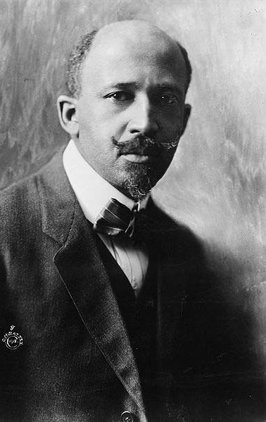
W. E. B. Du Bois
“The discovery of whiteness among the world’s peoples is a very modern thing… The ancient world would have laughed at such distinction… Today we have changed all that, and the world in a sudden, emotional conversion has discovered that it is white and by that token, wonderful!”
“I have seen a man – an educated gentleman – grow livid with anger because a little, silent, black woman is sitting by herself in a…car. I have seen a great grown man curse a little child, who had wondered into the wrong waiting room” (Du Bois, 1920)

Slide 3

Introduction
What Prejudice Is
Sources of Prejudice
Motivations for Prejudice
Consequences of Prejudice

Slide 4

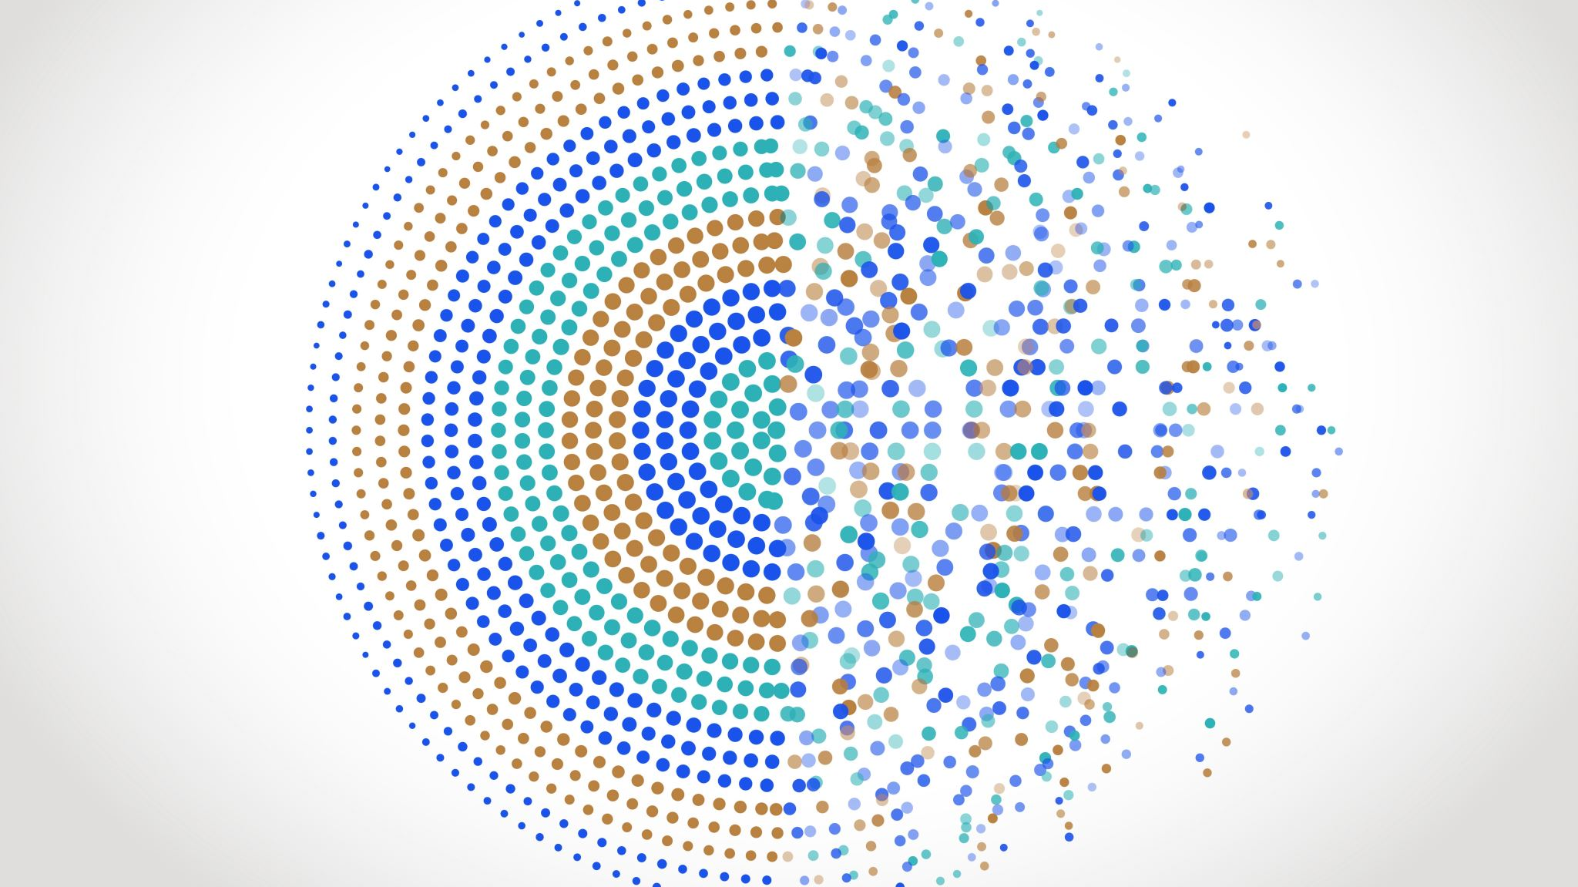

What is Prejudice?

Slide 5
Definitions
Prejudice
‘a negative prejudgement of a group and its individual members’
Attitude
Discrimination
‘unjustifiable negative behaviour toward a group or its members’
Behaviour
Stereotype
‘beliefs about the personal attributes of a group of people’

Slide 6
Implicit vs. Explicit Prejudice
Implicit Prejudice
Unconscious
Implicit Association Test
Explicit Prejudice
Conscious

Slide 7
Source of Prejudice
Inequality
Socialization
Ethnocentrism
Religion…..?

Slide 8
Unequal Status
Inequality Breeds Prejudice – Also Perpetuates It
Social Dominance Orientation
When groups want to achieve and maintain a higher social position

Slide 9
Socialization
Prejudice as Learned Behaviour
Role of the Family
Role of the Media

Slide 10
Ethnocentrism
The process where we judge another culture through the lens of our own
Use our lens to determine what is “Right” and what is “Wrong”
Ex. Female vs. Male Circumcision

Slide 11
Case: Relationship Between Religion and Prejudice
Are Religious People Prejudiced? Is Religion Itself Prejudiced?
Complicated question

Slide 12
Motivations of Prejudice
Scapegoat Theory
Social Identity Theory

Slide 13
Scapegoat Theory
Competition of Resources Fuels Prejudice
Tendency to Blame Another Group for Problems you Face

Slide 14
Social Identity Theory
Social Identity is our Identity that is Based on Group Membership
Part of this process includes:
Categorization
Identifying
Comparing

Slide 15
Consequences
Self-Fulfilling Prophecy
Victims of discrimination can internalize and blame themselves
Stereotype Threat
The experience of self-confirming apprehension when entering into a situation that you will be judged based on a negative stereotype

Slide 16

Have a Great Day!

